Slide 1
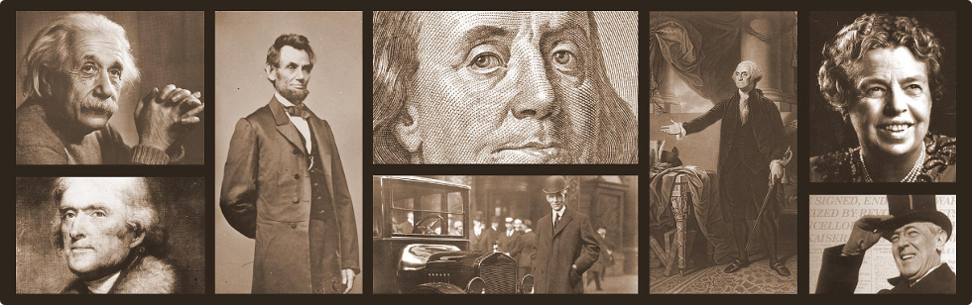
Wisdom About Work
Ecclesiastes 2:12-26
Dr. Rick Griffith • Crossroads International Church Singapore
CICFamily.com • BibleStudyDownloads.org

Slide 2

Hal Griffith

Slide 3
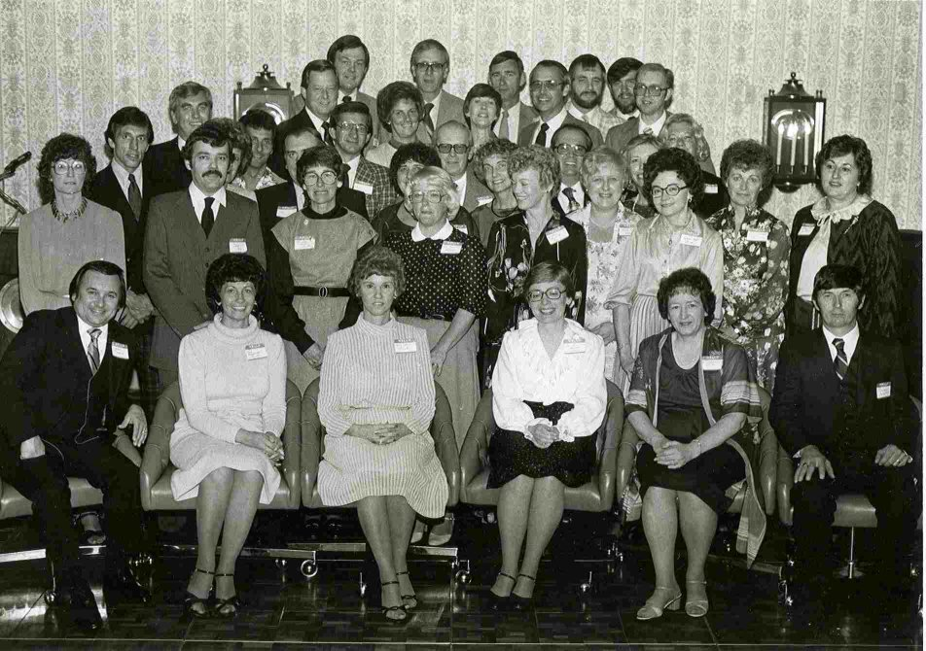

Hal Griffith

Slide 4

Are you satisfied with your life right now?
Notes:
Perhaps you say, “Well, yeah, basically. I’m where I want to be at this stage of my career.”
Others may be thinking, “Why do you ask? Have you heard something about me?” No, I’m asking because this is the issue in our passage today!

Slide 5

Are you satisfied with your life right now?
Notes:
Still others might have the attitude, “What do you mean by satisfied?” I’m talking about a genuine, deep sense of fulfillment in your being right now.
I suspect every one of us could be happier and more fulfilled, so let me ask this question…

Slide 6

What will it take for you to be really satisfied?
Notes:
We might say, “Well, if I just had more free time…”
You may be thinking, “A little more money might really help in the satisfaction department!”
Or, “Wow, if only so-and-so changed, I’d be happy!”

Slide 7

Solomon
Ecclesiastes
Notes:
Last week we saw that Solomon gave it his best shot to find real satisfaction.
http://churchsermonseriesideas.com/?s=ecclesiastes image

Slide 8
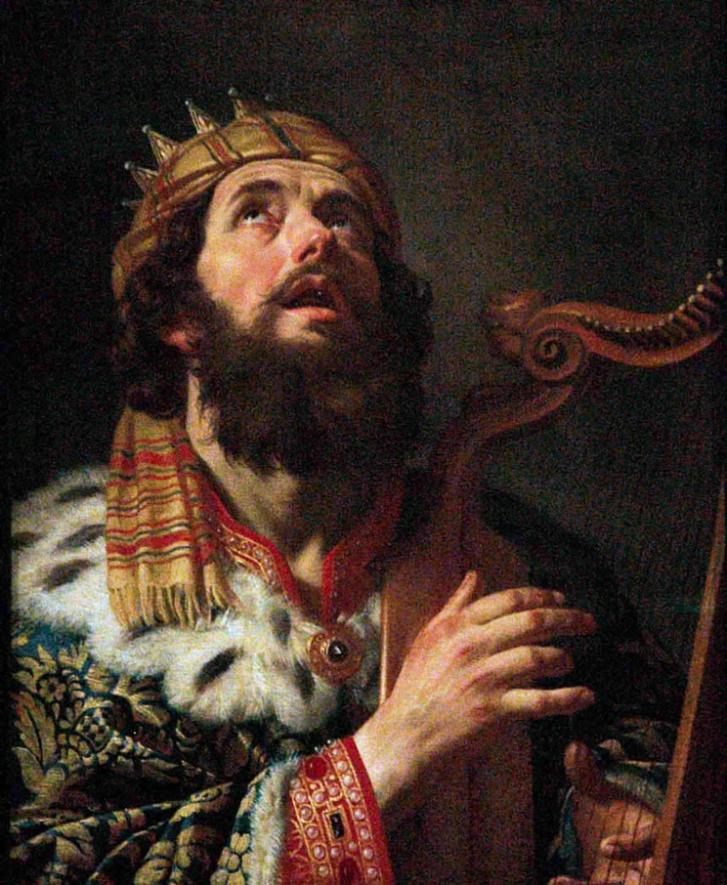

Israel's Golden Age

Slide 9
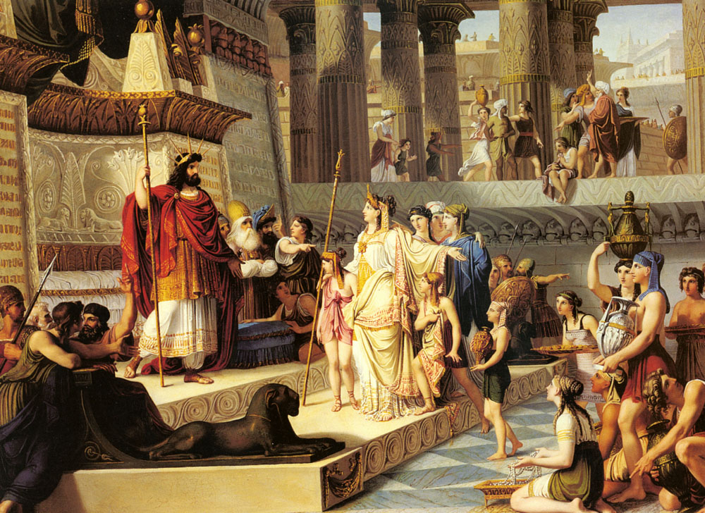
Israel's Golden Age

Slide 10
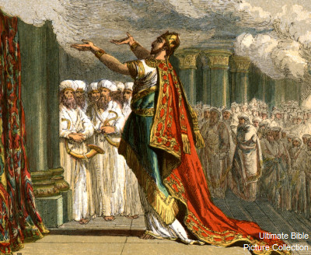
Israel's Golden Age

Slide 11
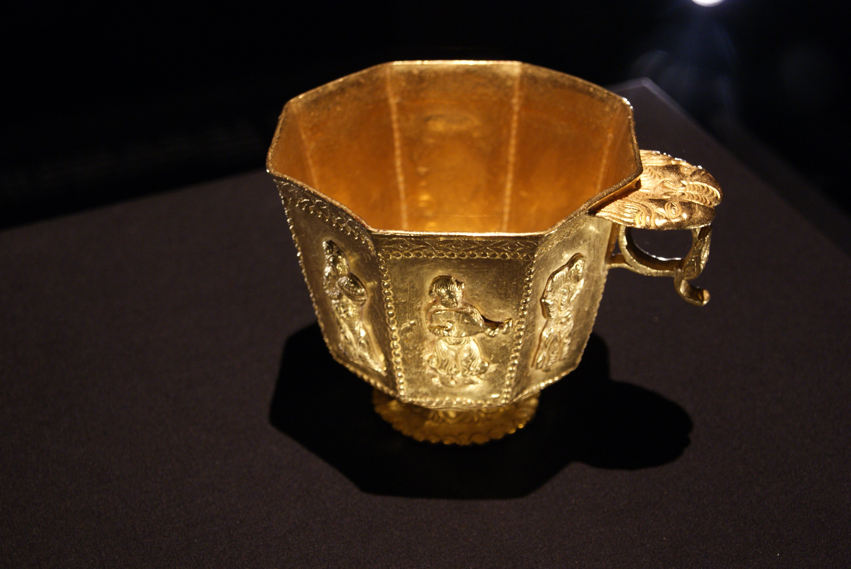
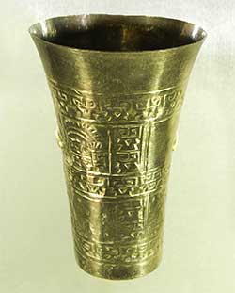
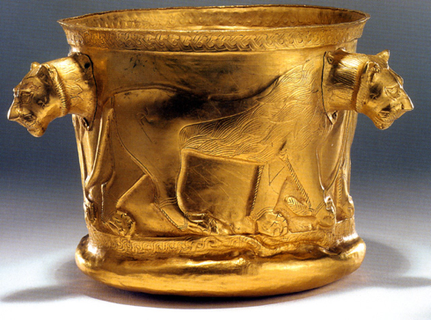
“All of King Solomon’s drinking cups were solid gold, as were all the utensils in the Palace of the Forest of Lebanon. They were not made of silver, for silver was considered worthless in Solomon’s day!”
(1 Kings 10:21 NLT).

Slide 12
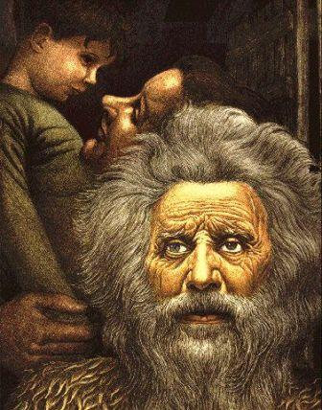
Reflections of an Old Man

Slide 13
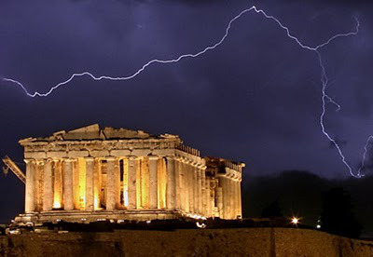
1. Prudence doesn't satisfy (1:16-18).

Slide 14



2. Pleasure doesn't satisfy (2:1-3).

Slide 15
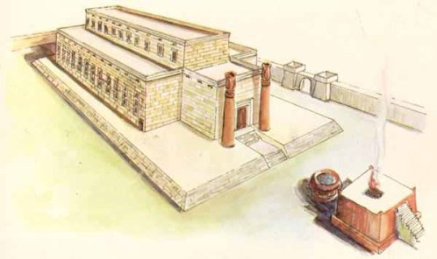
3. Projects don't satisfy (2:4-6).

Slide 16
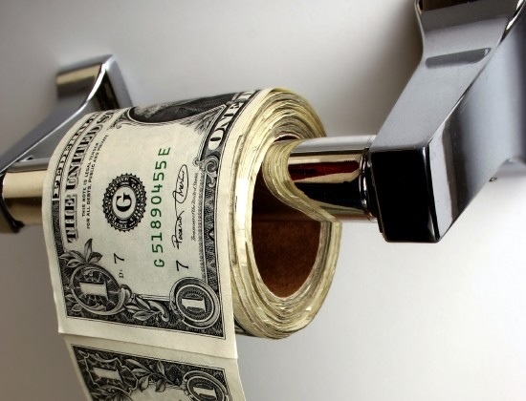
4. Possessions don't satisfy (2:7-8).

Slide 17

5. Power doesn't satisfy (2:9).
"So I became greater than all who had lived in Jerusalem before me, and my wisdom never failed me."

Slide 18

"Anything I wanted, I would take. I denied myself no pleasure. I even found great pleasure in hard work, a reward for all my labors. ¹¹But as I looked at everything I had worked so hard to accomplish, it was all so meaningless—like chasing the wind. There was nothing really worthwhile anywhere."
Profitless Pursuits Conclusion (2:10-11 NLT)

Slide 19


Where we're going today…
Ecclesiastes 2:12-26
Two Final Pursuits
Where to Find Real Satisfaction

Slide 20

So where should we not look for satisfaction?

Slide 21
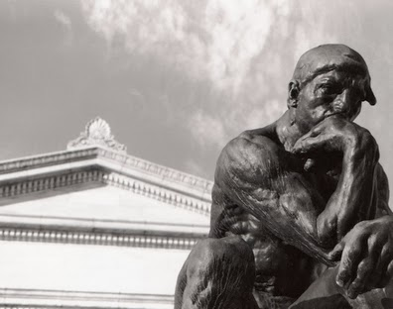
I. Don't look for satisfaction in wisdom or work (2:12-23).
Notes:
Neither your knowledge nor your job will really give you joy

Slide 22

Wisdom doesn't satisfy because both the wise man and the fool die (2:12-17).

Slide 23
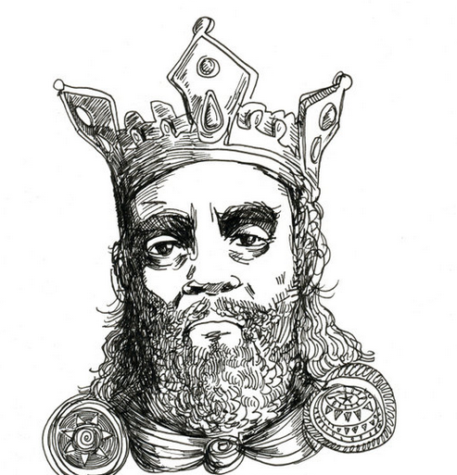
Solomon saw his wisdom as unsurpassable (2:12 NLT).
"So I decided to compare wisdom with foolishness and madness (for who can do this better than I, the king?)"

Slide 24
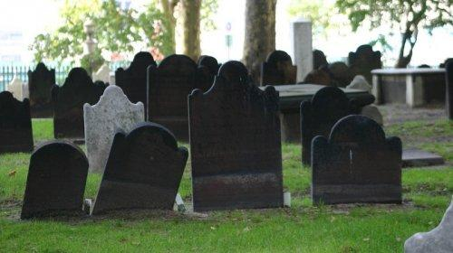
Wisdom is better than foolishness but has no ultimate advantage since all die (2:13-16).

Slide 25

"I thought, 'Wisdom is better than foolishness, just as light is better than darkness'" (2:13 NLT).

Slide 26
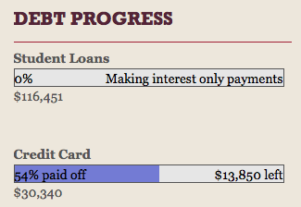

http://doubledebtsinglewoman.com/

Slide 27

"'For the wise can see where they are going, but fools walk in the dark.' Yet I saw that the wise and the foolish share the same fate"
(2:14 NLT).

Slide 28

"Both will die. So I said to myself, 'Since I will end up the same as the fool, what's the value of all my wisdom? This is all so meaningless!'" (2:15 NLT).
Same Fate

Slide 29
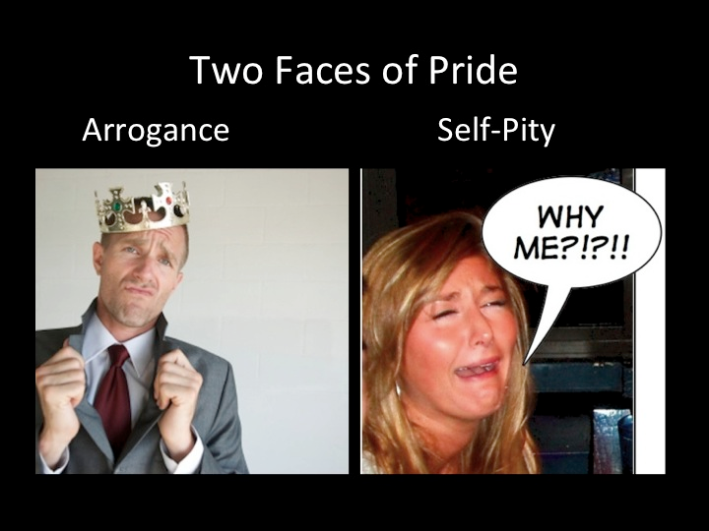
Pride over wisdom
Two Foolish Faces:
Arrogance
Self Pity
WHY ME?!?!?!
Regret over foolishness

Slide 30
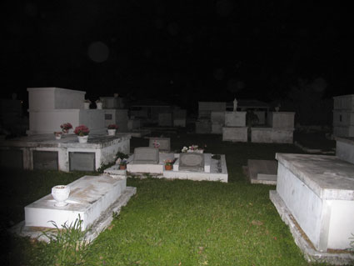
"For the wise and the foolish both die. The wise will not be remembered any longer than the fool. In the days to come, both will be forgotten" (2:16 NLT).

Slide 31

"So I came to hate life because everything done here under the sun is so troubling. Everything is meaningless—like chasing the wind" (2:17 NLT).

Slide 32

PhD

Slide 33

PhD = Permanent Head Damage
How many dissertations are even read?

Slide 34


What else doesn't satisfy?
Wisdom
Work

Slide 35

Work doesn't satisfy because the fruit of one's labor may be squandered (2:18-23).

Slide 36

"I came to hate all my hard work here on earth, for I must leave to others everything I have earned. ¹⁹And who can tell whether my successors will be wise or foolish? Yet they will control everything I have gained by my skill and hard work under the sun. How meaningless! ²⁰So I gave up in despair, questioning the value of all my hard work in this world"
(2:18-20 NLT).

Slide 37

"Some people work wisely with knowledge and skill, then must leave the fruit of their efforts to someone who hasn't worked for it. This, too, is meaningless, a great tragedy"
(2:21 NLT).

Slide 38
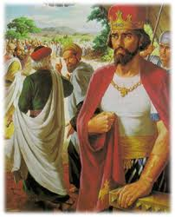
Rehoboam

Slide 39
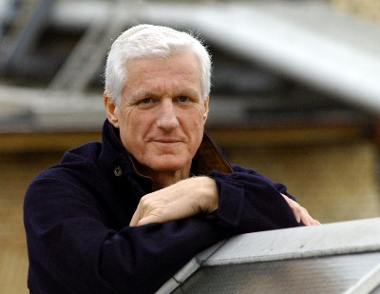
Freidrich Flick
Notes:
Newsweek magazine reported about this German industrialist, “When West German industrialist Freidrich Flick died, he left a personal fortune estimated at $1.5 billion… a business empire that embraced all or part of some 300 firms, and a reputation as perhaps the crustiest and craftiest magnate ever to operate on the German business scene.
Flick was dedicated wholly to his work (he buried his wife at 3 PM one day in 1966 and was back at his desk two hours later)…
At his death, the Flick empire generated annual sales in excess of $3 billion… but for all his enormous power and wealth, the old man had one very human shortcoming: he could not control his family. By last week a Flick family fight over der alter Herr’s empire had employees, bankers and politicians alike wondering over the eventual impact it might have on the West German economy.”
Newsweek magazine, 25 Sept 1972; cited by Charles R. Swindoll, Living on the Ragged Edge (Waco, Texas: Word, 1985), 59-60.

Slide 40

Charles R. Swindoll, Living on the Ragged Edge, 59
Ecclesiastes
Notes:
Charles Swindoll notes, “Let me get painfully personal. I do not care how capable, how competent, how perfectly suited your children may be to continue your dream, there’s something in you they don’t possess and never will possess… you’re indomitable, innovative spirit. You were the original dreamer, the tough-minded pioneer. You hammered that dream out on the anvil of time. Though you had nothing, you came to something. And no matter how closely you’ve had your children work alongside you, there’s something you’ve got that they lack. And that’s what worries you, right?” (ibid.).

Slide 41

"So what do people get in this life for all their hard work and anxiety? ²³Their days of labor are filled with pain and grief; even at night their minds cannot rest. It is all meaningless" (2:22-23 NLT).

Slide 42

Cover
Prudence
Pleasure
Projects
Possessions
Power
Wisdom
Work
Profitless Pursuits
Under the Sun

Slide 43

II. You will be satisfied only when you please God (2:24-26).
Notes:
Living the way God wants is the only way to genuinely find joy

Slide 44

God grants many benefits from work to those who please him (2:24-26).

Slide 45

"So I decided there is nothing better than to enjoy food and drink…"
(2:24a NLT).

Slide 46
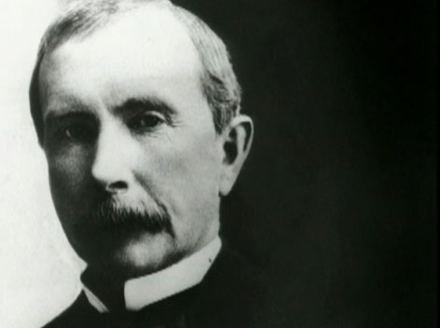
John D. Rockefeller
Notes:
“In his book, The Rockefeller Billions, Jules Abels says that John D. Rockefeller had an income of approximately a million dollars a week toward the end of his life. Yet his doctors allowed him to eat only a bare minimum. One of his biographers said he lived on a diet a pauper would have hated. ‘Now, less than 100 pounds in weight, he sampled everything (at breakfast): a drop of coffee, a spoonful of cereal, a forkful of egg, and a bit of chop the size of a pea.’ Rockefeller was the richest man in the world, but he didn’t have the ability to enjoy even his food.”

Slide 47


"So I decided there is nothing better than…to find satisfaction in work. Then I realized that these pleasures are from the hand of God" (2:24b NLT).

Slide 48

"For who can eat or enjoy anything apart from him?" (2:25 NLT).

Slide 49
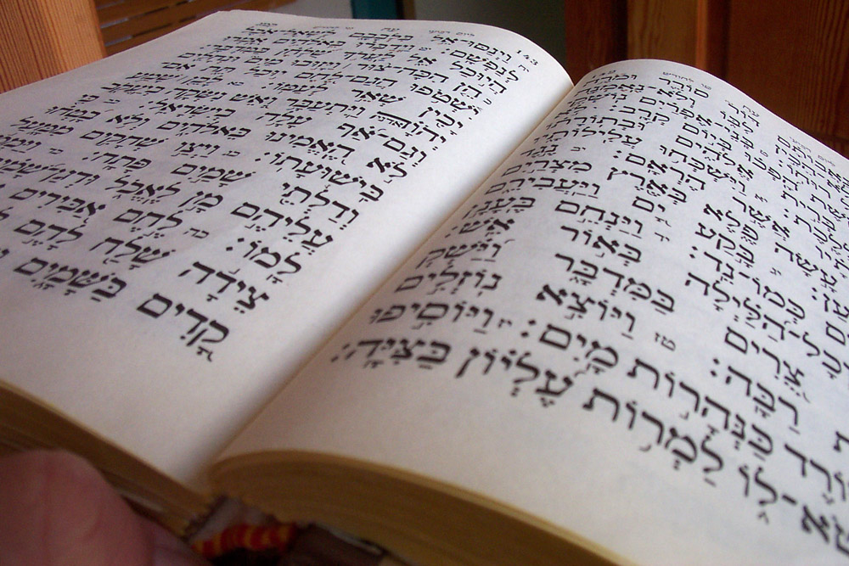
"God gives wisdom, knowledge, and joy to those who please him" (2:26a NLT).

Slide 50

"But if a sinner becomes wealthy, God takes the wealth away and gives it to those who please him.
This, too, is meaningless—like chasing the wind" (2:26b NLT).

Slide 51

Can you honestly say that your highest goal in life is to please God?

Slide 52
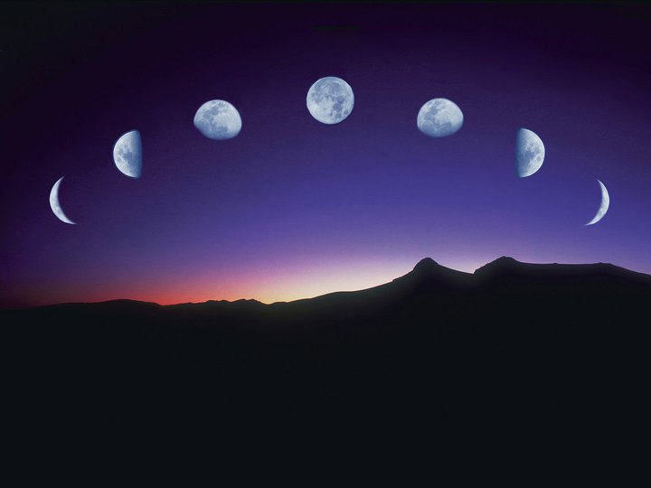
Our Study in Ecclesiastes
Work & Wisdom Don’t Last

Slide 53
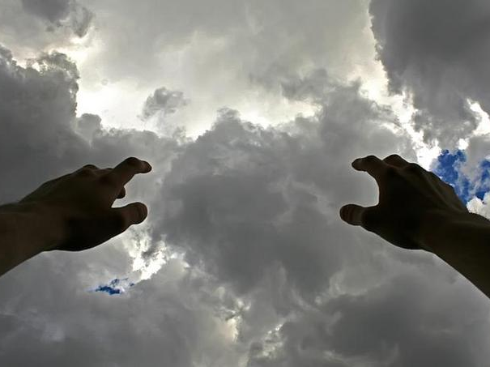
Wisdom and work don't satisfy
Main Idea of 2:12-26
unless you please God.

Slide 54

But how do you please God?
By Faith!

Slide 55

Hebrews 11:6

Slide 56

Wisdom is a worthy goal, but are you seeking fulfillment in wisdom—or in pleasing God?
Notes:
Do you believe that doing well in school will bring satisfaction?
Do you feel that holding a significant position at church will satisfy?

Slide 57

Working hard is also admirable, but do you seek fulfillment in work—or in pleasing God?
Notes:
Do you really have to work as hard as you do?
How much do you serve your goals? (Who is the master—you or your goals?)

Slide 58

"You will either offend the world and please God, or please the world and offend God."
—John Hagee

Slide 59
Tell God that your highest goal is to please Him.

Slide 61


OT Preaching link at BibleStudyDownloads.org
Get this presentation and script for free!

